Slide 1
DELE CA1 Part A : CNN
Tan Eu Zin
P2415927
DAAA/FT/2B/22
Starting with data cleaning and observation…

Slide 2
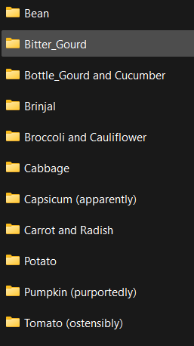
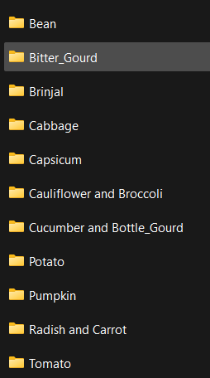
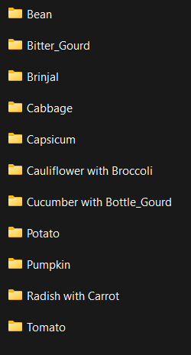
Test folder
Train folder
Validation folder
The folders, which are also the labels, are not named uniformly, so I will rename them

Slide 3
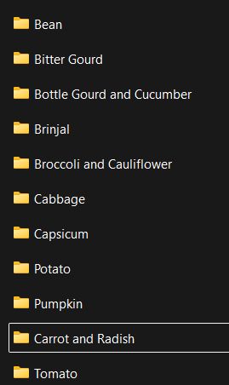
After changing folder names to be uniform, this is names for all labels across all 3 folders

Slide 4
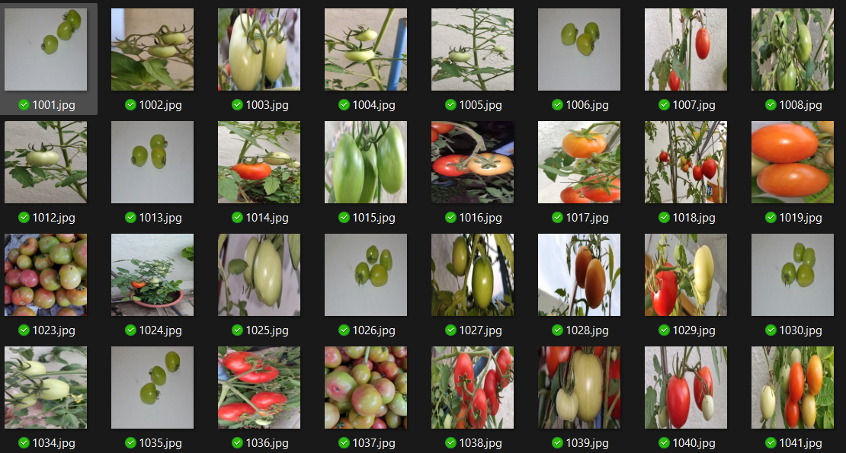
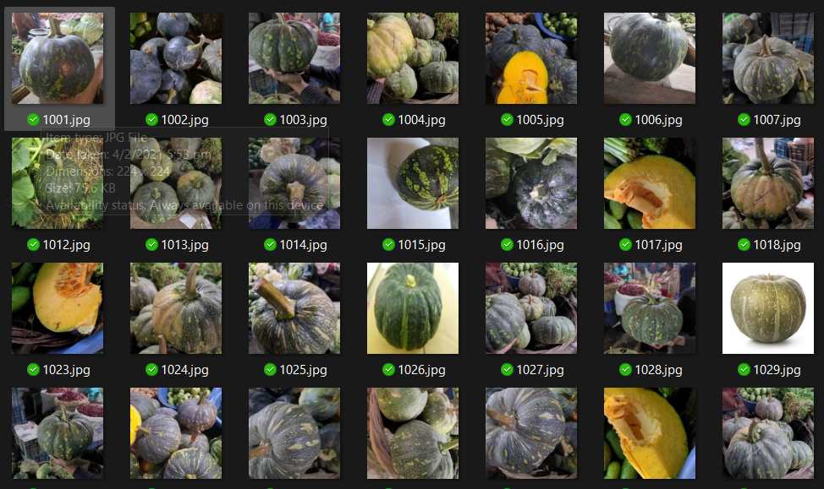
Train – pumpkin folder looks like tomatoes
Train – tomato folder has photos of pumpkins
Labels for these two folders will be switched. Folders will be renamed accordingly.
Now data is clean!!!

Slide 5
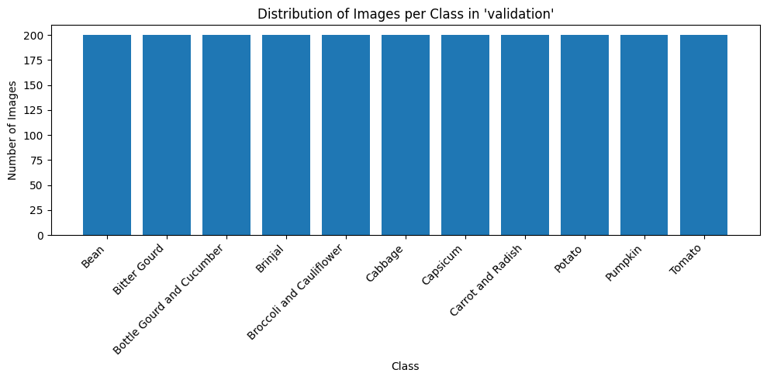
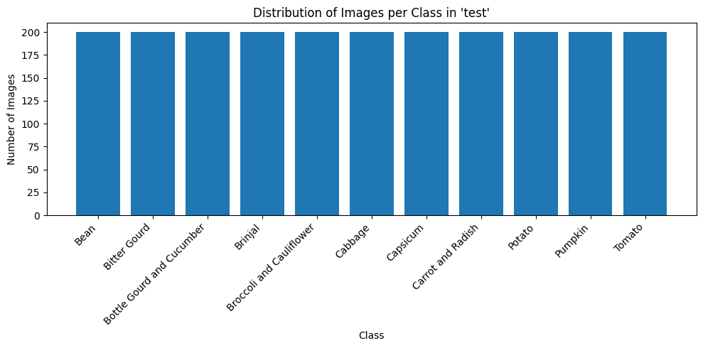
Now we visualize the sum of data in each label, it is equal for the validation and test dataset.

Slide 6
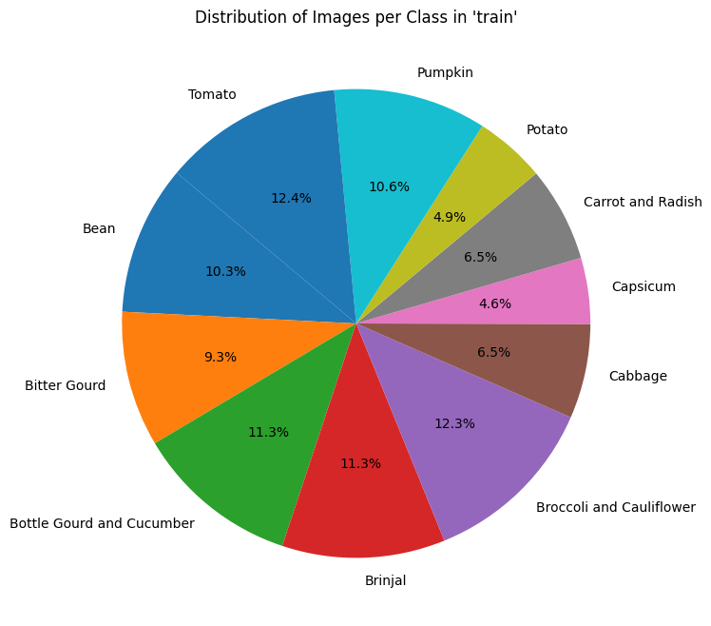
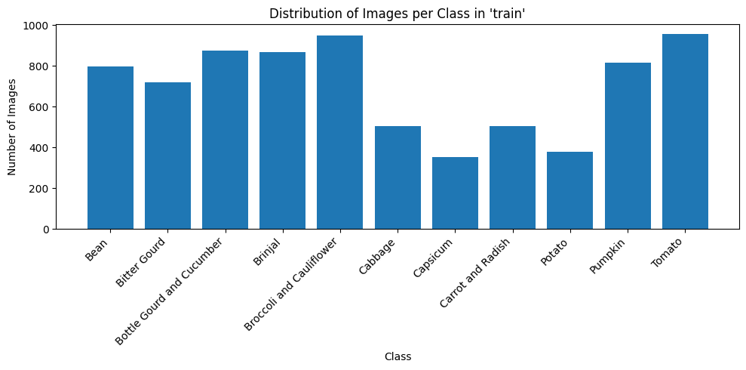
However, for the train dataset, it is biased and not equal, some classes obviously have much more data and some with much less, may lead to model being biased (better at predicting some labels and worse at predicting others)
Hence, we will carry out data augmentation, it will be carried out after importing data as both datasets will be different ( 101 and 23 pixels ), which will artificially create more data for smaller classes, decreasing the range of difference in count.

Slide 7
IMPORTING DATA FOR 23 AND 101 PIXEL MODELS
Imported data for 23 pixels : train_ds_23, test_ds_23, val_ds_23
Imported data for 101 pixels : train_ds_101, test_ds_101, val_ds_101

Slide 8
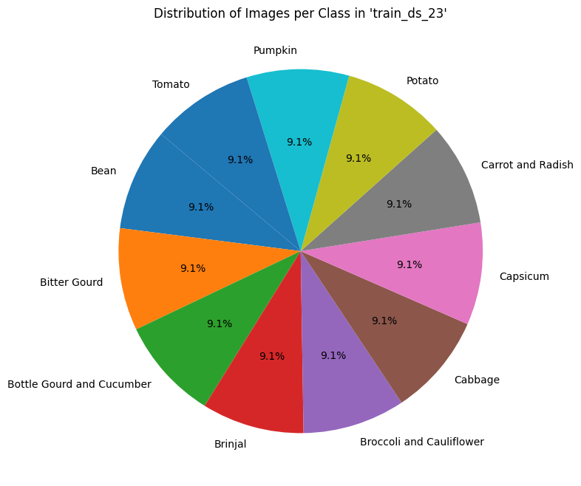
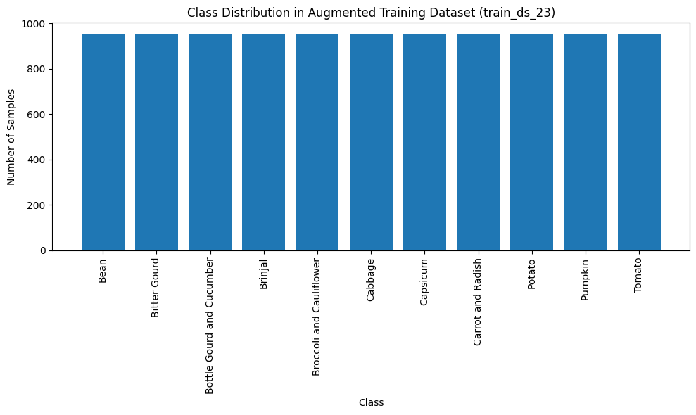
Now we augment the data and ensure that minority classes (Capsicum, Potato, Cabbage, Carrot and Radish) have successfully been augmented and the data is more balanced compared to before for 23 and 101

Slide 9
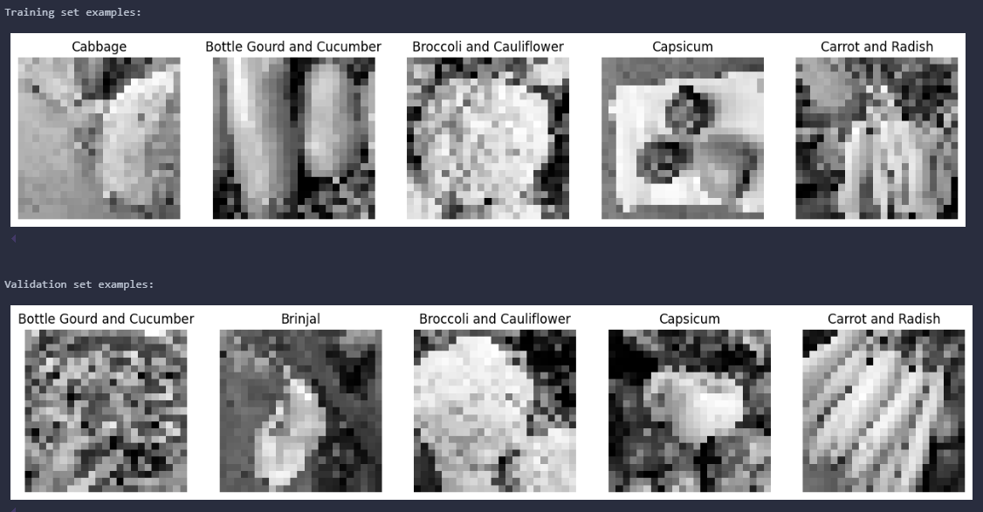
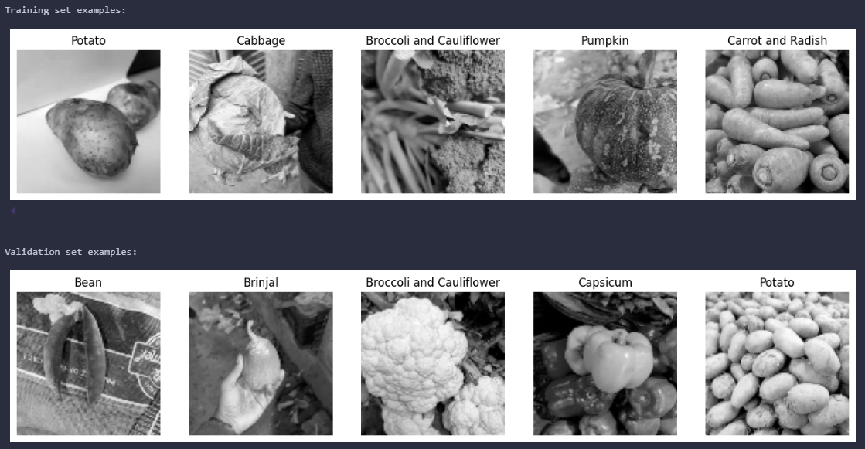
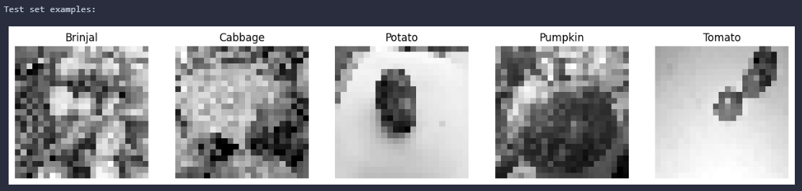
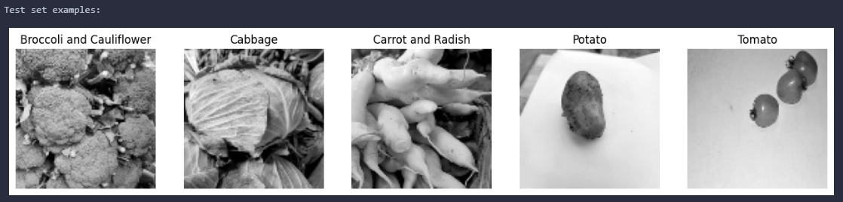
Check that data imported has labels, is grayscale, and are in correct pixels to be used by both models.
Examples of train, test and val data for 23x23 pixels :
Examples of train, test and val data for 101x101 pixels :

Slide 10
23 x 23

Slide 11
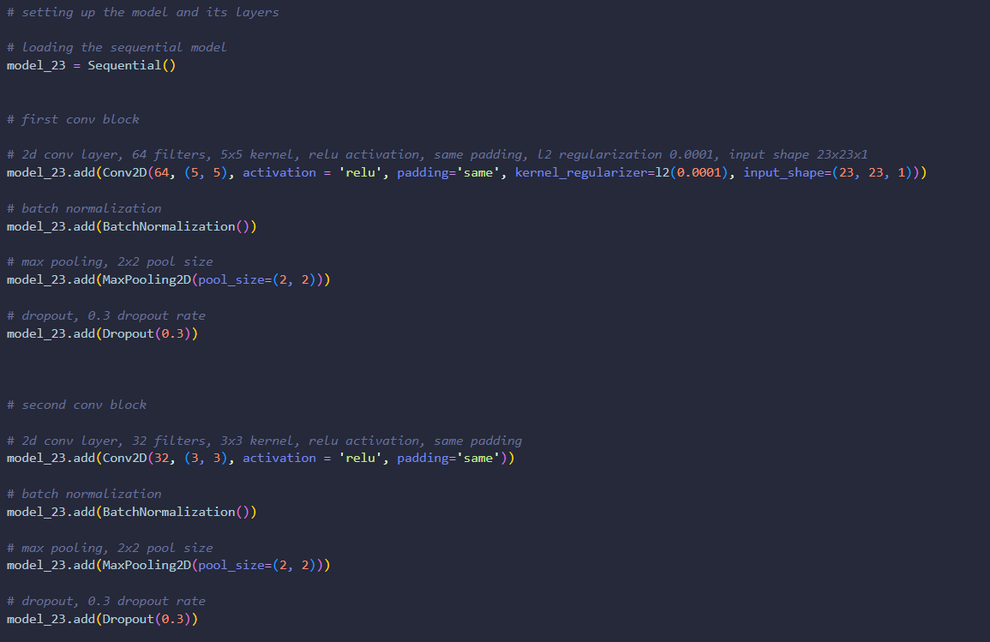
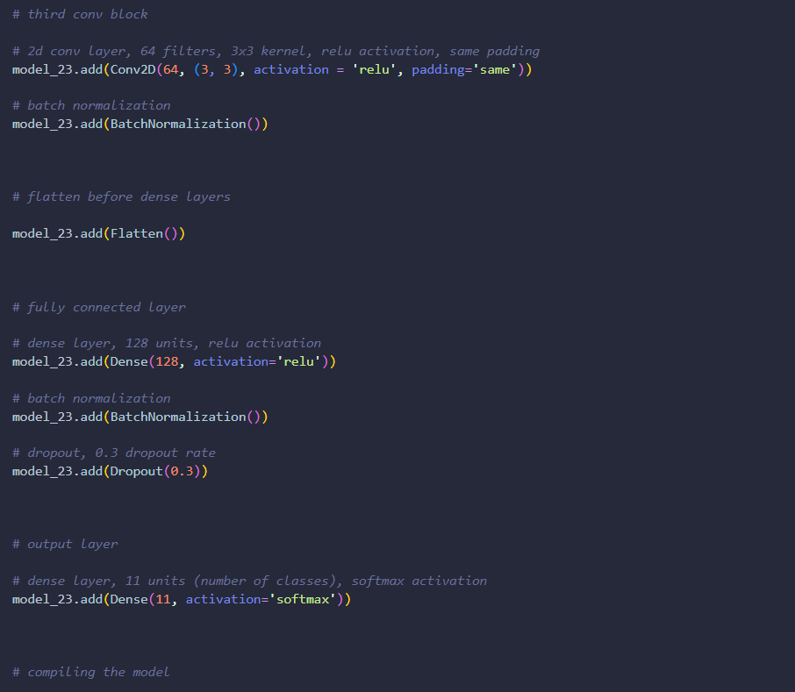
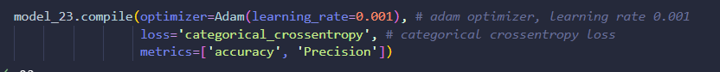
Now we define our base 23x23 model : This model with its layers was experimented with and slowly derived by adding layers, changing parameters manually through repeated visualisation, to ensure that it is not overfitting (or at least not overfitting too much), and since the layers are tuned manually, this will not be tuned again.

Slide 12
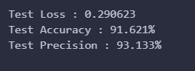
This model makes use of early stopping and reduceLROnPlateau when fitting on train data, and this is the result
We use categorical_crossentropy loss as this is the usual loss metric for multi-class classification, and accuracy as it is a metric to measure general performance for classification models. We also use precision to track the number of true positives.

Slide 13
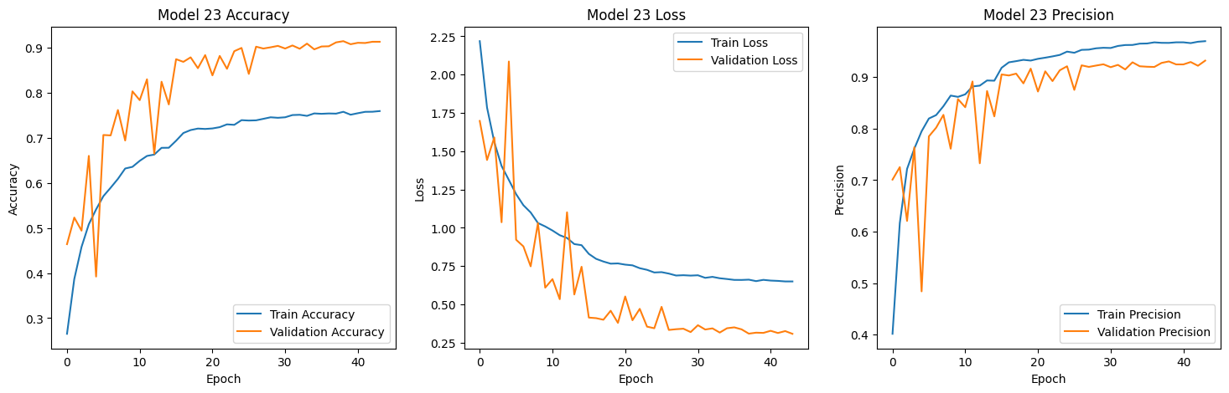
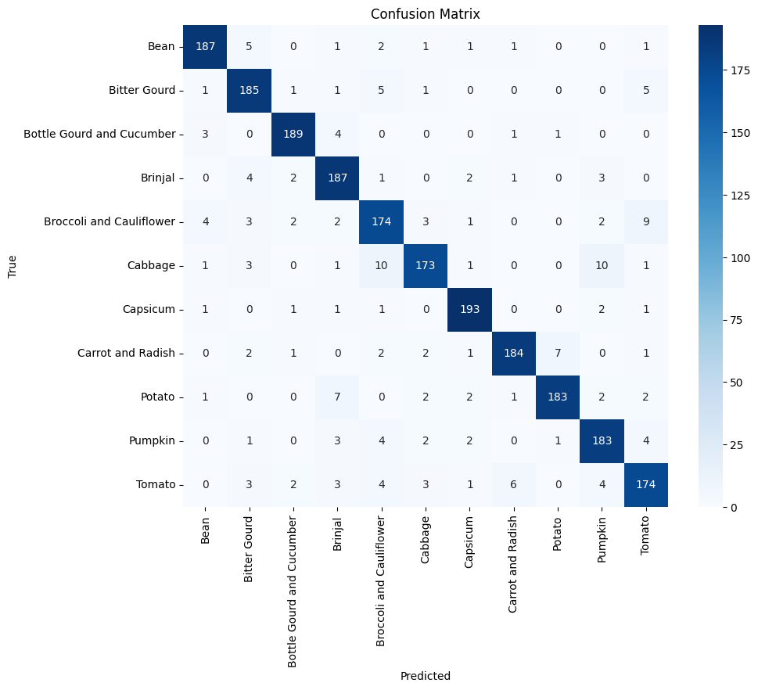
Looking at the history plots, the model seems to be generalizing well after being tuned manually to get the best result. Now we can proceed to hyperparameter tuning.
We can see the model generalizes well and it generally predicts most of the labels correctly, but there are some common areas of false positives where mistakes are generally made. We will try hyperparameter tuning to make the model better first.

Slide 14
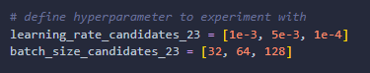
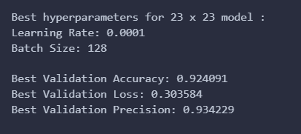
We will tune the learning rate and batch size, which are parameters not inside the layers of the CNN model.
After hyperparameter tuning, these are the best performing hyperparameters that we got, now we fill fit our final model with the new hyperparameters.

Slide 15
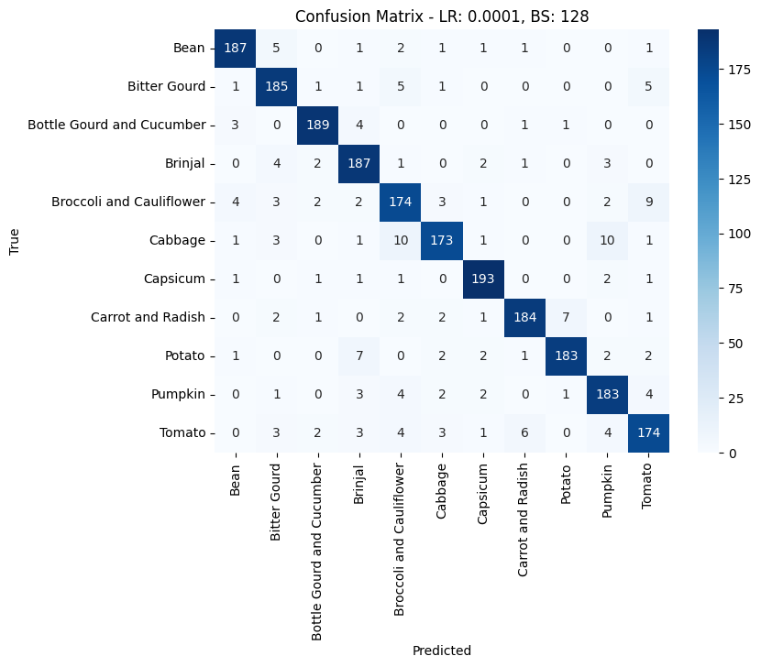

CLASS WEIGHTS
While tuning, we see that there is an issue where there are always patches on the confusion matrix (more than 10 false positives), and it always occurs at the same place :

Slide 16
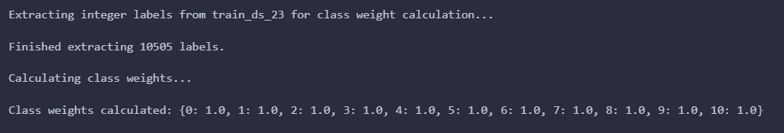
We will use class weights to fix this issue. Class weights rebalances the importance of each sample during training which shifts the models focus to learning the distinguishing features instead of just getting minimizing overall loss.

Slide 17
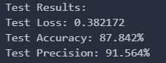
Final test result
Initial test result
We see that the final test result is not as good as the initial test result, with lower precision, higher loss, and lower accuracy.

Slide 18
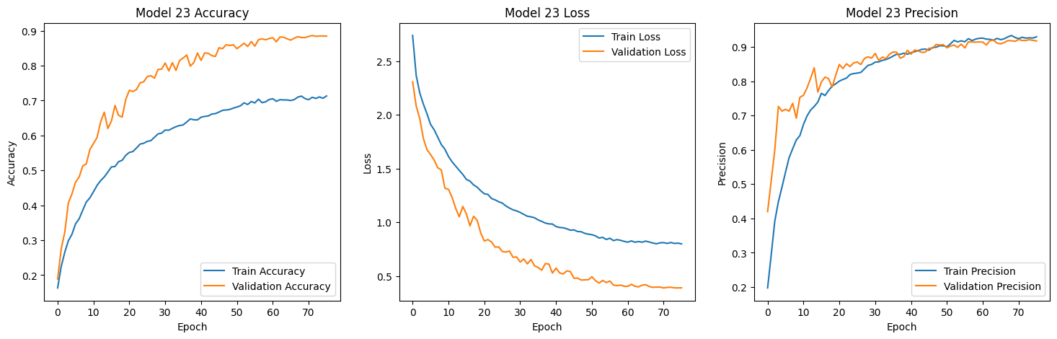
Final test result
Initial test result
Through the graphs, we can see however that the final model generalizes better on the data compared to the base model and is more consistent. This shows an improvement.

Slide 19

Initial test result
Final test result
However, looking at the CM, the final model seems to be performing worse after the class weightage and hyperparameter tuning. This led to more patches forming than before. The class weights might have placed the importance of predicting each class correctly wrongly which caused this.

Slide 20
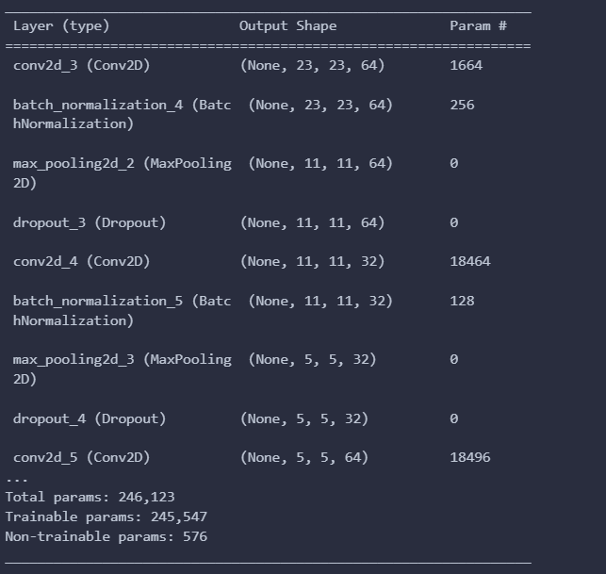

Slide 21
101 x 101

Slide 22
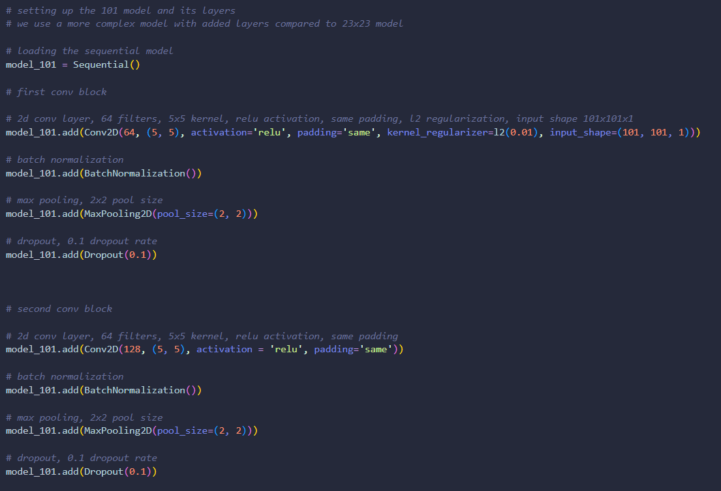
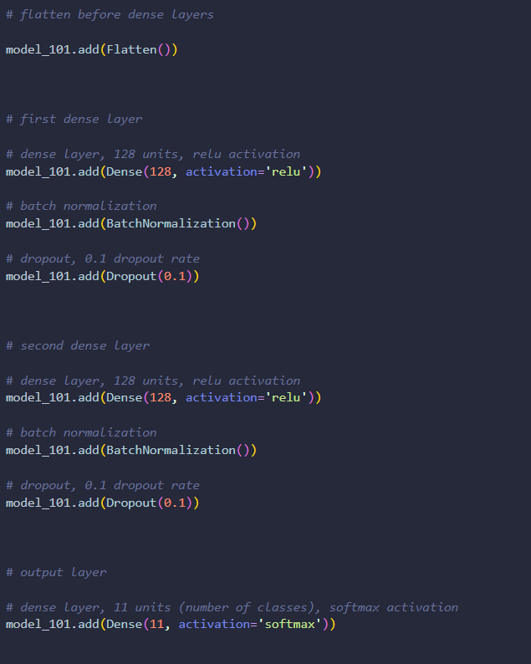
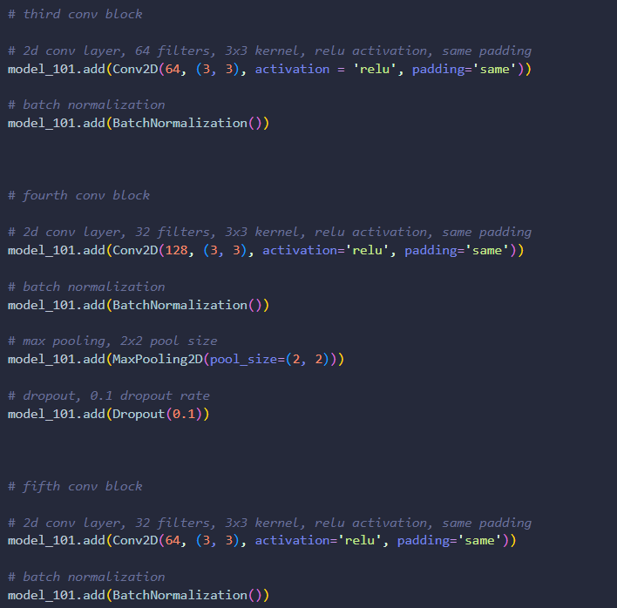
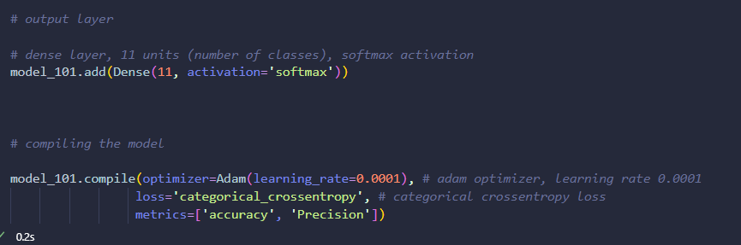
We define our manually tuned 101x101 model too, hyperparameters will not be tuned anymore, and model is more complex as data is more complex due to increased pixels, so model can keep up.

Slide 23
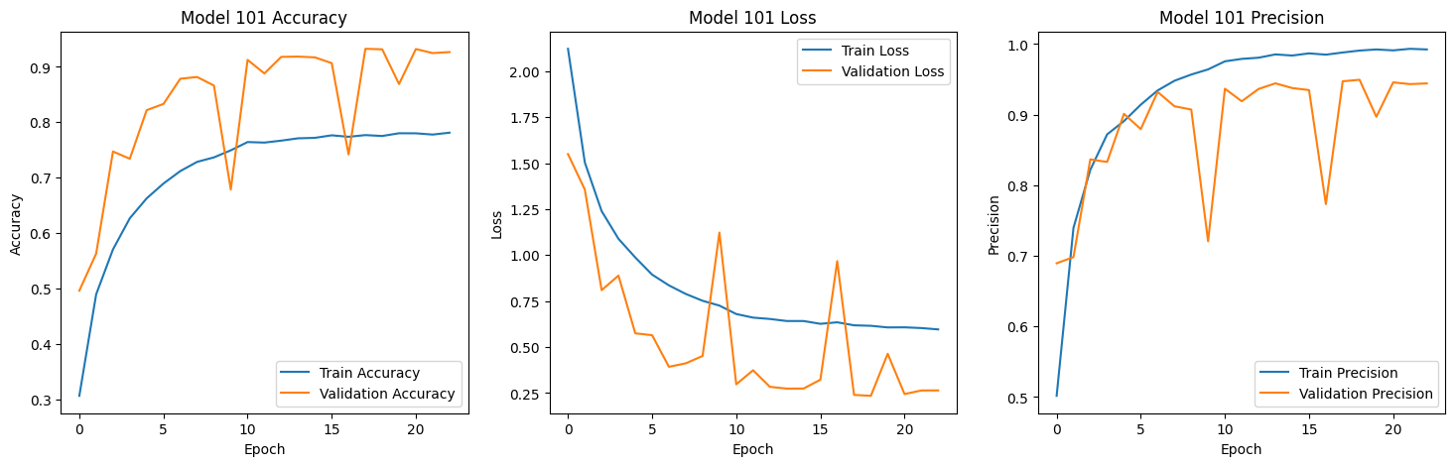
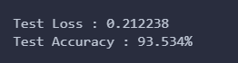
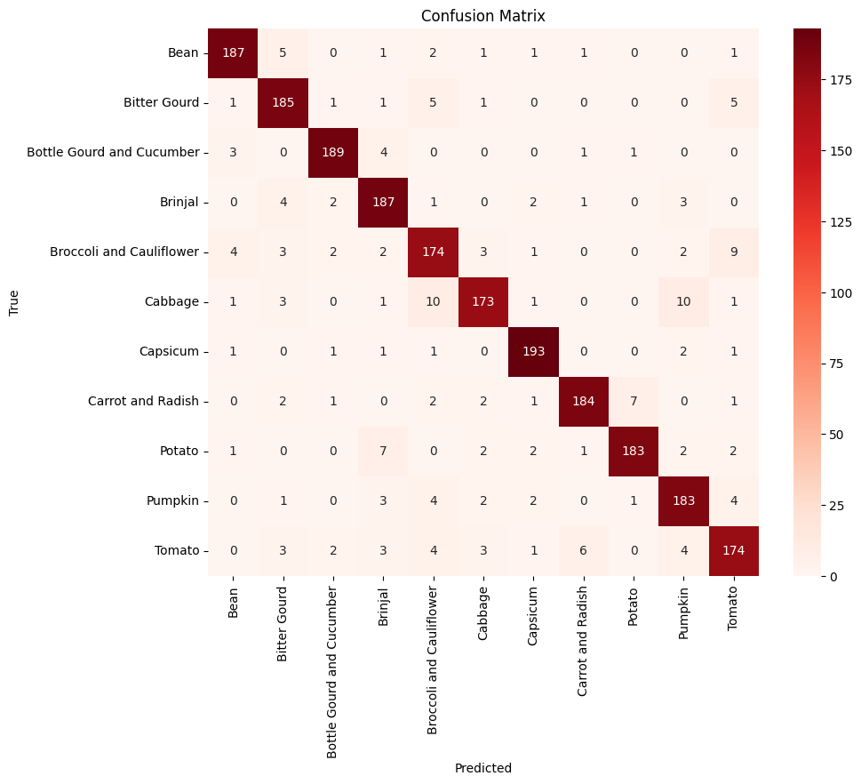
The model does not generalize well with the data with many fluctuations looking at the plots, but when it comes to CM, it has the same patching issue as the 23x23 model. The model does have a pretty low loss score and a high test accuracy. Now we will tune the model to improve it

Slide 24
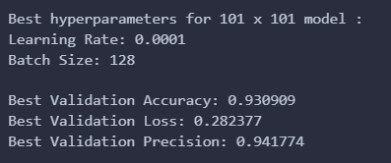
Now we will tune the model as well in the same way and this is the result we got. These are the model’s best parameters.

Slide 25
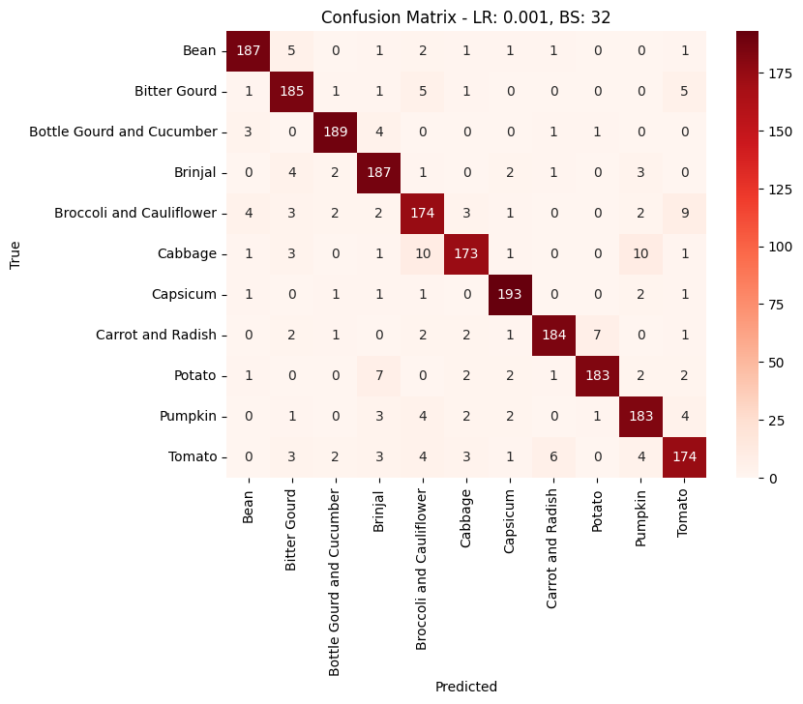

CLASS WEIGHTS
Since there is the same issue, we shall carry out class weights again, with the same reason as before

Slide 26
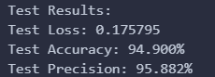
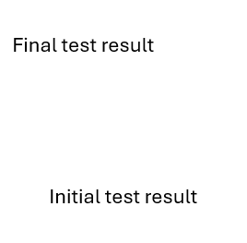
The final model had a lower loss and a higher accuracy for the model.
Precision wise, made a mistake for the base hence no result, but expected for final model to do better too.

Slide 27
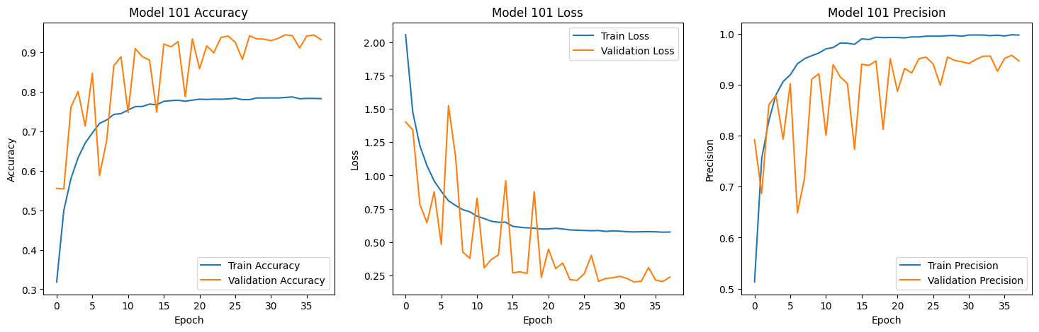
Final model
base model
We can see that the final model also generalizes better than the base model and is more consistent around the val and train differences.

Slide 28
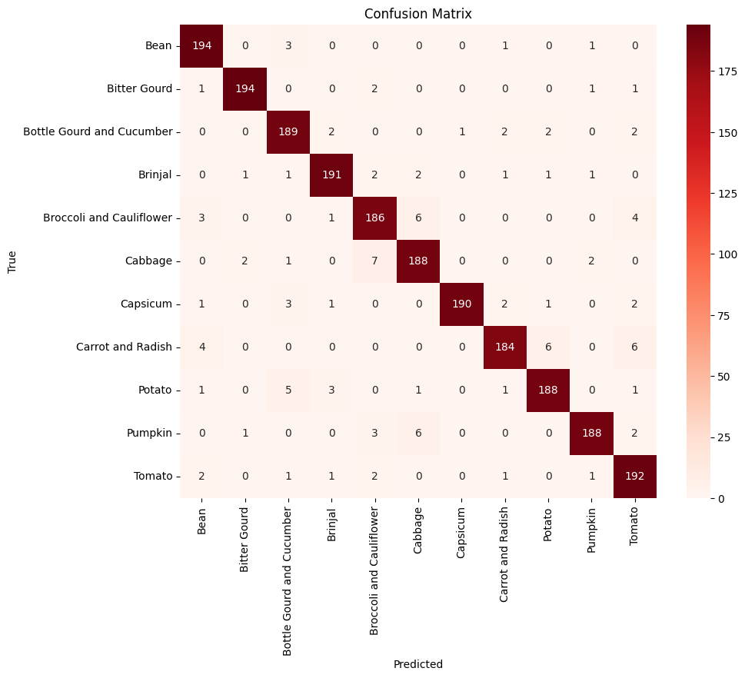
Final
Base
We can also see that the patching problem (10+ false positives) is gone in the tuned and class weighted final model, there is improvement

Slide 29
Comparing both 23 x 23 model and 101 x 101 model.
23 model’s metrics
101 model’s metrics
We can see that the final models 23x23 and 101x101 pixels, the 101 is performing better with lower loss and higher accuracy, and also higher precision.
This is expected as logically speaking, it is easier to classify data if the data is clearer, so the model with clearer photos (101x101 pixels) is expected to perform better.
However, this also makes the data more complex so the model should be tuned to fit the complexity of the data properly.

Slide 30
23x23 model’s confusion matrix :
101x101 model’s confusion matrix :
We can also see that there are less false positives in the 101x101 model compared to the 23x23 model, suggesting the 101x101 performed much better than the 23x23 model. It also meant that the model is capturing the features better as the patching issue is gone.

Slide 31
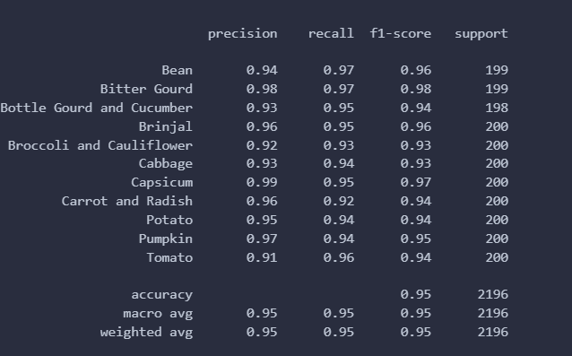
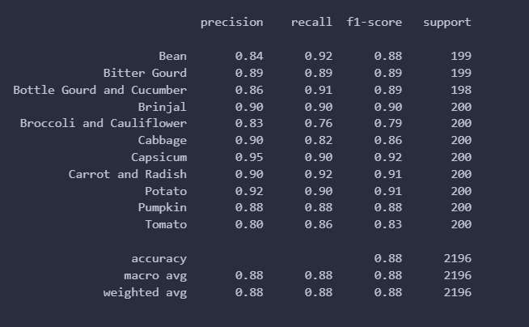
101
Viewing the classification report for 23x23 and 101x101 model.
Looking at the average precision, recall and f1-score, the 101x101 model is also performing better than the 23x23 model. It is safe to conclude the 101x101 model is performing much better than the 23x23 model.
It can also be concluded that efforts to tune and improve (class weights) models were effective and caused a positive impact.

Slide 32
THE END

